Slide 1
Aligning the SLP’s work with education standards
Lissa Power-deFur, Ph.D., CCC-SLP

Slide 2





Longwood?
Kappa Delta—October 23, 1887
Sigma Sigma Sigma—April 20, 1898
Zeta Tau Alpha—October 15, 1898
Alpha Sigma Alpha—November 15, 1901

Slide 3
As a school-based SLP, you are told that you must start to address the education standards in your IEPs and interventions.
With your caseload and obligations you wonder, “just HOW can I do one MORE thing?”

Slide 4
Learning Objectives – Participants will be able to …
explain the purpose and expectations of educational standards.
describe the language and linguistic expectations of education standards.
contrast the language and linguistic expectations of academic standards with the skills of children with communication disorders.
plan individual and collaborative activities that integrate children's acquisition of communication skills with their acquisition of education standards.

Slide 5



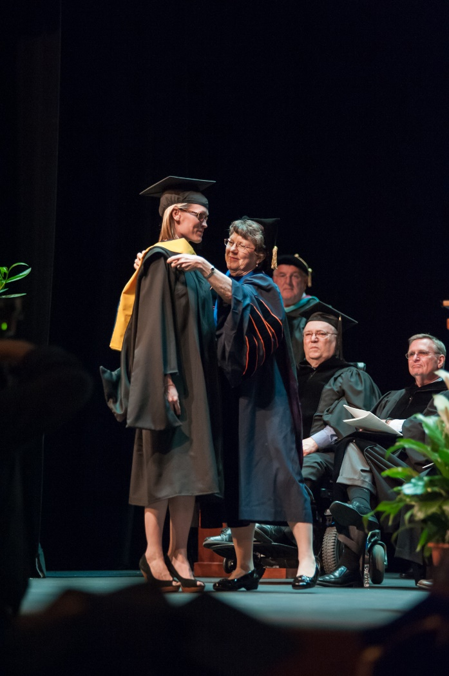


Slide 6
Disclosures
Financial
Lissa has a financial arrangements with WVSHU for this presentation
Lissa published a book on the CCSS and SLPs with Plural Publishing
Nonfinancial
Lissa thanks her colleagues who authored chapters in the CCSS book, sharing their expertise

Slide 7
Purpose of the education standards

Slide 8
Imagine you have been invited to develop new standards for WVa
What are traits you would like to see in HS graduates?
What expectations do you have of the standards?

Slide 9

2010
Critical readers
Thoughtfully engaged with literary and informational texts
Cogent reasoning skills
Deliberate use of evidence
Responsible citizens
Notes:
Not how to teach, but the K&S student need.

Slide 10



Source?
Council of Chief State School Officers (CCSSO)
National Governors Association (NGA)
With financial support from the Bill and Melinda Gates Foundation

Slide 11





Common standards facilitate education of students in our mobile society and economies of scale in assessments and texts
Image from wellsbrooke.com

Slide 12
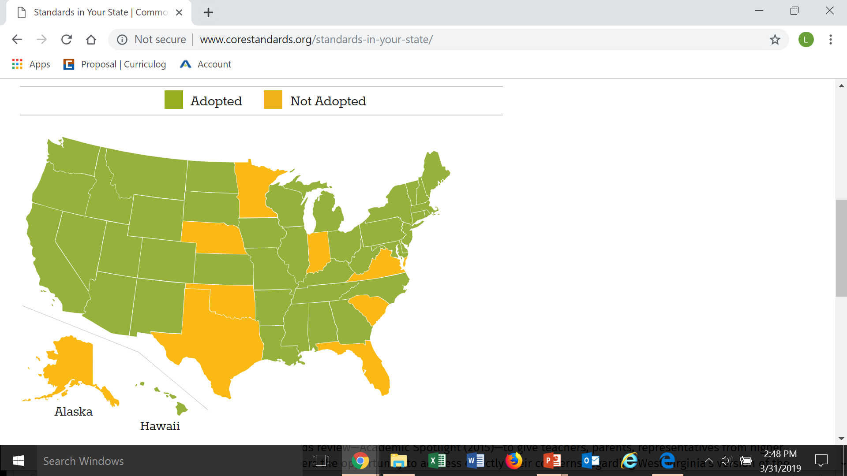
45 states adopted in 2010
9 repealed
21 states made revisions

Slide 13
The standards have high expectations in language arts
Comprehend and evaluate texts
Construct arguments and convey intricate information
Adapt communication to varying demands of audience, task, purpose, discipline
Understand other perspectives and cultures
Which have underlying expectations of skills in phonology, morphology and syntax, semantics and pragmatics

Slide 14
Are the standards appropriate?
Laura Justice comments that the ELA standards are more developmentally appropriate than prior state standards.
Larry Ainsworth notes that the ELA standards (in comparison with prior standards) are
Clearer (improved clarity and specificity)
Higher (increased rigor)

Slide 15
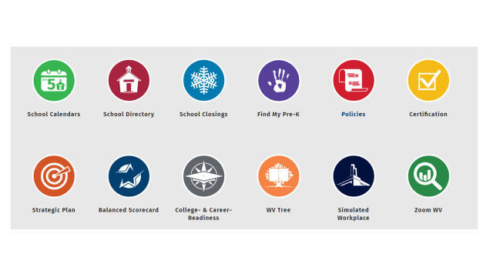
WVa Standards
Repealed W Va version of CCSS Dec 2015
Educator involvement
Implemented WV College and Career Readiness Standards (WVCCR) July 2016

Slide 16
Purpose of WVCCR (WVDOE web site)
Prepare students for today’s and tomorrow’s job market
Develop real-world skills
Challenge students to
  Think critically
  Absorb information
  Draw conclusions
  Communicate successfully

Slide 17
Standards are not curriculum
Schools will develop curriculum to meet local students’ needs, based on the standards

Slide 18
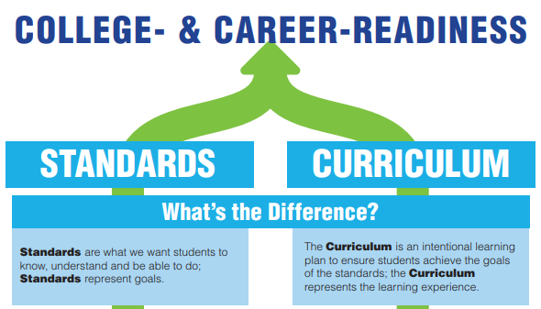
Notes:
West Virginia Department of Education. (n.d.). College- & career-readiness. [PDF file]. Retrieved from https://wvde.us/wp-content/uploads/2018/01/pathway_standardsvcurriculum.pdf

Slide 19
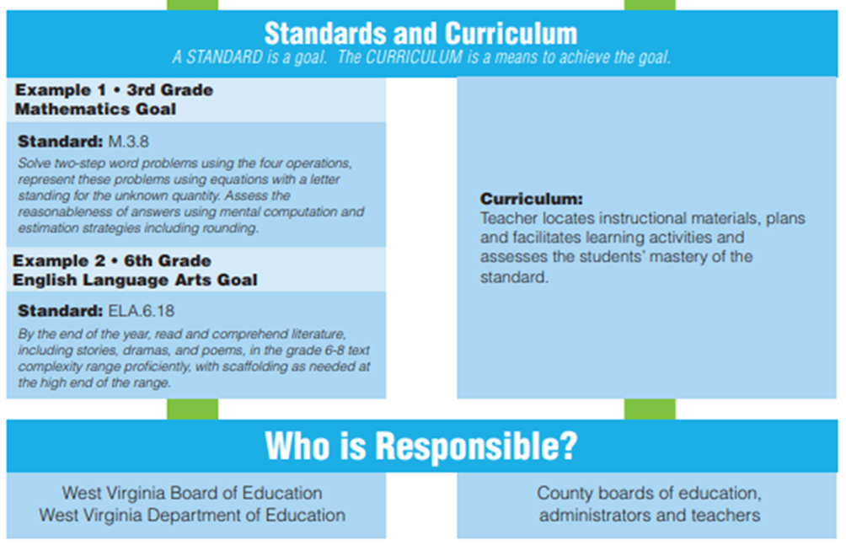
Notes:
West Virginia Department of Education. (n.d.). College- & career-readiness. [PDF file]. Retrieved from https://wvde.us/wp-content/uploads/2018/01/pathway_standardsvcurriculum.pdf

Slide 20

The standards build upon one another, creating increasing complexity with each year.
Notes:
Copy page 30 and disseminate here

Slide 21
Common Core Language Skills
Standard | Grades
L.3. 1f Ensure subject-verb and pronoun-antecedent agreement | 3 – 12
L. 3. 3a Choose words and phrases for effect | 3 – 12
L.4.1f Produce complete sentences (correct fragments and run-ons) | 4 – 12
L. 4. 1g Correctly use frequently confused words (i.e. homonyms) | 4 - 12
L.5. 1d Recognize and correct inappropriate shifts in verb tense | 5 - 12
L.6. 1c Recognize and correct vague pronouns (unclear antecedents) | 6 - 12
L.6. 3a. Vary sentence patterns for meaning, listener interest, & style. | 6 - 12
L. 7. 3a Place phrases & clauses within a sentence, correcting misplaced modifiers | 7 - 12
L. 8. d. Recognize &correct inappropriate shifts in verb voice & mood | 8 - 12
L. 9. 10.1a Use parallel structure | 9 - 12

Slide 22
What about students with disabilities?
“Students with disabilities … must be challenged to excel within the general curriculum”

Slide 23
“High-quality, evidence-based, individualized instruction and support services.”
supports, accommodations, and related services to meet the unique needs of students with disabilities
IEP goals will be aligned with and chosen to facilitate student attainment of standards

Slide 24
Students with more severe disabilities
Dynamic Learning Maps (dynamiclearningmaps.org)
National Center and State Collaborative (http://www.ncscpartners.org/resources
WV Alternate Academic Achievement Standards (Policy 2520.16) provide alternate standards that are aligned to the WVCCR Standards. (WV DOE, All Things Alternate, WV DOE web site)

Slide 25
The standards-based IEP movement fits well with education standards
The W VA CCR (and other education standards) are the general education achievement standards
The IEP teams uses these to gauge the gap between a child’s performance and the academic expectations

Slide 26


However, the standards do not become the IEP goals
Where is the individualization for students’ unique needs?
If the standards are expected for all students, where is the specially designed-instruction?
Openclipart.org

Slide 27
Linguistic expectations of standards

Slide 28
Speaking and Listening Expectations
Students gain, evaluate and present increasingly complex information, ideas and evidence through listening, speaking and the media
Focus is on academic discussion in 1:1, small-group and whole-class settings
Formal presentation and informal discussion

Slide 29
Kinder-garten | a) Follow agreed-upon rules for discussions (e.g., listening to others and taking turns speaking about the topics and texts under discussion b) Continue a conversation through multiple exchanges
Grade 1 Additional expectations | b) Build on others’ talk in conversations by responding to the comments of others through multiple exchanges. c) Ask questions to clear up any confusion about the topics and texts under discussion.
Grade 2 Additional expectations | a) Gaining the floor in respectful ways, b) Linking their comments to the remark of others. c) Ask for clarification and further explanation as needed

Slide 30
Grade 3 Additional expectations | Having discussions with diverse partners, building on others’ ideas and expressing their own clearly. a) prepared and draw preparation to explore ideas c) Ask questions to check understanding, stay on topic, and link their comments to others. d) Explain own ideas and understanding
Grade 4 Additional expectations | b) carry out assigned roles in discussions c) Pose and respond to specific questions to clarify or follow up on information d) Review the key ideas
Grade 5 Additional expectations | d) Draw conclusions in light of information and knowledge gained from the discussions.

Slide 31
Grade 6
Grades 9 - 10
Present information, findings, and supporting evidence clearly, concisely, and logically such that listeners can follow the line of reasoning and the organization, development, substance, and style are appropriate to purpose, audience, and task.
Adapt speech to a variety of contexts and tasks, demonstrating command of formal English when indicated or appropriate

Slide 32
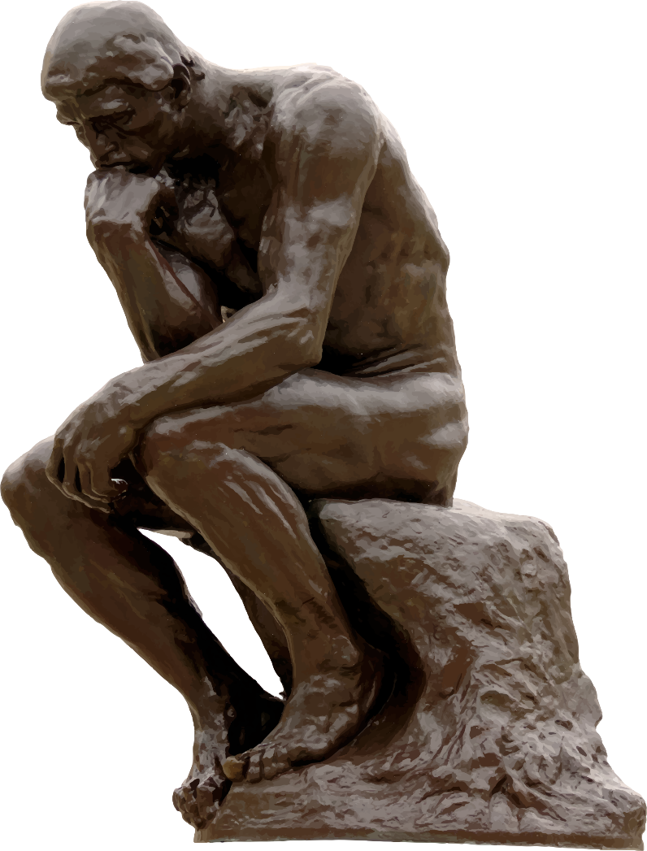
Ponder …
How can I collaborate with teachers in my building to support these language skills?
Openclipart.org

Slide 33
Language expectations
Students grow their vocabularies through conversations, direction instruction, and readings
Students determine word meanings, appreciate nuances
Students use formal English in writing and speaking
Students choose among the many ways to express themselves

Slide 34
Conventions of Standard English
Nouns | Grade level expectation
 |  | Expectation
 | G1 | Common, proper and possessive nouns Match singular/plural nouns with verbs
 | G2 | Collective nouns Irregular plural nouns
 | G3 | Regular and irregular plural nouns Abstract nouns Explain function of nouns

Slide 35
Verbs
G 1 | Convey past, present, and future tense
G 2 | Create past tense for frequently occurring irregular verbs
G 3 | Use simple verbs tenses (e.g., walks, walked, will walk)
G 4 | Use progressive, modal auxiliaries (e.g., can, may, must)
G 5 | Use perfect tense (e.g., had walked, have walked, will have walked)
G 8 | Explains functions of verbals (gerunds, participles, infinitives) Uses passive voice Uses verbs for mood (indicative, imperative, interrogative, conditional and subjective)

Slide 36
Pronouns
G 1 | Personal, possessive, indefinite
G 2 | Reflexive Explain function of pronouns
G 4 | Relative (e.g., who, whose, whom, which, that)
G 6 | Corrects inappropriate shifts in pronoun number and person Corrects ambiguous pronouns

Slide 37
Conjunctions and Adverbs
1 | Uses frequently occurring conjunctions (e.g., and, so, but, or, because)
3 | Uses coordinating & subordinating conjunctions
4 | Uses relative adverbs (e.g., where, when, why)
5 | Uses correlative conjunctions (e.g., either/or) Explain function of conjunctions

Slide 38
Vocabulary: Determine & clarify meaning
 | Identifying meaning
K | Identify new meanings for familiar words (duck)
G 1, 2, 3 | Use sentence-level context as clue to meaning
G 4 | Use context (e.g., definitions, examples, or restatements within text) as a clue to meaning
G 5 | Use context (e.g., cause/effect relations, comparisons) as a clue to meaning

Slide 39
“Orally tested vocabulary in G1 was correlated with much later reading comprehension.” Biemiller (2005)
Reading comprehension relies on vocabulary comprehension; without this students recognize words in print rather than understanding them.

Slide 40

Academic Vocabulary
Marzano’s analysis of 28 standards documents revealed 7,923 vocabulary terms in 11 subject areas
  K-2: 782 terms
  3 – 5: 2,398 terms
  6 – 8: 2,352 terms
  9 - 12: 2,391 terms

Slide 41
Larger vocabulary  Larger vocabulary
  Children with larger vocabularies acquire new words at a faster rate (Biemiller)
  Lowest quartile learn approx.
    1.5 root words/day for 7 years
  Highest quartile learn approx.
    3 root words/day for 7 years
3000 vs. 8000
root words!

Slide 42
“Our best estimate is that there are about 88,500 distinct words”
Nagy and Anderson, 1984
Marzano (2004)estimates that students must master 1,150 to 3,150 new words annually
Primarily discipline-specific words (Tier 3)
Marzano (2004) suggests that children need 6 – 10 exposures to a word in context for mastery
To truly master new words, student must
* understand it,
* internalize it,
* remember it, and
* use it correctly (Marzano & Simms, 201

Slide 43
Inflections and roots
 | Inflections and root words
K | Use the most frequently occurring inflections and affixes (-ed, -s, re-, un-, pre-, -ful, -less) as a clue to meaning
G 1 | Identify frequently occurring root words and inflectional forms (e.g., look, looks, looked, looking)
G 2, 3 | Determine meaning of new word formed when known prefix/affix is added (e.g., happy/unhappy)
G 4, 5 | Use common, grade-appropriate Greek and Latin affixes and roots as clues to meaning (e.g., telegraph, photograph, autograph)

Slide 44
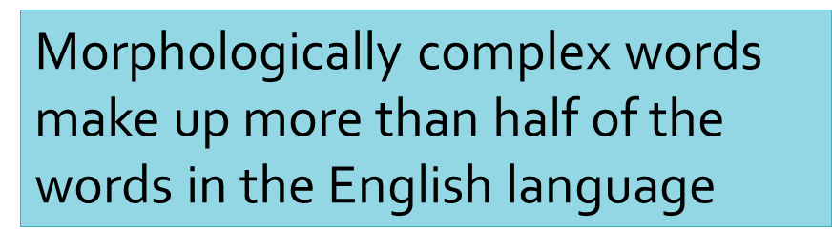
Word analysis defines interrelatedness among words
Divide
Divided
Dividend
Dividers
Dividing
Divisible
Division
Divisional
Divisor

Slide 45
Activity
What affixes should you address in intervention?

Slide 46
Explore word relationships
 | Categories and attributes
K, G1 | Sort common objects into categories
K | Understand frequently occurring verbs and adjectives by relating them to their antonyms
G 1 | Define words by category and one or more key attributes (e.g., a duck is a bird that swims)

Slide 47
Categories found in a Grade 2 text
Food
Sea animals
Colors
Occupations
Farm animals
Continents
Hobbies
Seasons
Pets

Slide 48
Activity: Categories
How would you support students’ ability to master categories such as sea animals? Continents?

Slide 49
Nuances of meaning
 | Nuances of meaning
G 3 | Distinguish literal and nonliteral meanings of words and phrases (e.g., take steps)
G 4 | Explain meaning of simple similes and metaphors (e.g., pretty as a picture)
G 4, 5 | Explain meaning of common idioms, adages, and proverbs
G 5 | Use relationship between words (synonyms, antonyms, homographs) to understand words

Slide 50
High expectations for mastery of figurative language
(with G3 – 5 examples)
Similes
  As old as the hills
  The book was as heavy as an elephant
Metaphors
  I breathed a song into the air
  A blanket of snow covered the field

Slide 51
Idioms
  She had to throw in the towel
  The teacher told them to “go with the flow”
Adages
  Two wrongs don’t make a right
  Better safe than sorry
Proverbs
  An apple a day keeps the doctor away
  Birds of a feather flock together
Personification (“opportunity is knocking”)

Slide 52
Activity : Figurative meaning
Develop a strategy to help students understand any of the figurative language tasks on the prior slides.

Slide 53
Standards include Tier 1, 2, and 3 vocabulary
Tier 1 – basic vocabulary
Tier 2 – high frequency general academic vocabulary
  Used in adult conversation (not child’s)
  Often intangible
Tier 3 – Low-frequency, content/discipline specific words
  Difficult to paraphrase into Tier 1 and 2 words

Slide 54
 | Use grade-appropriate conversation, general academic and domain-specific words and phrases
G 3 | … including those for spatial and temporal relationships (e.g., after dinner …)
G 4 | … including those that signal precise actions, emotions, or states of being (e.g., quizzed), and are basic to a particular topic (e.g., wildlife)
G 5 | … including those that signal contrast, addition, and other logical relationships (e.g., however, similarly)

Slide 55
 | Use grade-appropriate conversation, general academic and domain-specific words and phrases
G 3 | … including those for spatial and temporal relationships (e.g., after dinner …)
G 4 | … including those that signal precise actions, emotions, or states of being (e.g., quizzed), and are basic to a particular topic (e.g., wildlife)
G 5 | … including those that signal contrast, addition, and other logical relationships (e.g., however, similarly)

Slide 56
What should be our focus?
  Tier 2 – which are basic to comprehension of academics
  Tier 3 - strategies to use to learn
    Morphological detective skills

Slide 57
Activity
Tier 2 and 3 Words
While reviewing the following slides of illustrative words, identify 2 – 3 you can start using in intervention

Slide 58
Common Tier 2 words (Marzano & Simms, 2013)
Are you using these in your conversations with your students?
Arrange | Execute | Introduce
Combine | Exemplify | Label
Compare | Generate | Participate
Construct | Improve | Recognize
contribute | initiate | Sort

Slide 59
Tier 3: Language Arts
(from Marzano and Simms)
Action word (K) | Future tense (G 1) | Adjective (G 2) | Conjunction (G 3)
Noun (K) | Plural (G 1) | Common noun (G 2) | Personal pronoun (G 3)
Verb (K) | Singular (G 1) | Pronoun (G 2) | Preposition (G 3)
Article (G 1) | Prefix (G 2) | Adverb (G 3) | Part of speech (G 3)
Past Tense (G 1) | Suffix (G 2) | Affix (G 3) | Comparative (G 4)

Slide 60
Tier 3 –Math
(From Marzano and Simms)
Corner (K) | Cone (G 1) | Hexagon (2) | Graph (G 3)
Fourth (K) | Attribute (G 2) | Polygon (G 3) | Percent (5)
Equal (K) | Fraction (G 2) | Billionth (G 3) | Ordinal number (G 6)
Greater than (G 1) | Trapezoid (G 2) | Sequence (G 3) | Cardinal number (G 6)

Slide 61
Tier 3: Language Arts
Character (K) | Quote (G 3) | Proverb (G 3) | Pun (G 4)
Setting (G 1) | Theme (G 3) | Apology (G 3) | Reflection (G 5)
Lesson (G 1) | Simile (G 3) | Role (G 3) | Irony (G 6)
Prefix (G 2) | Argument (G 3) | Alliteration (G 4) | Context (G 6)

Slide 62
Selecting your target vocabulary
Comprehension increases by 1/3 with focus on specific words important to content
Knowledge of a given vocabulary term deepens over time if a student encounters the word multiple times.
          (Marzano, 2004)

Slide 63

What New Ideas to You Have?

Slide 64
Remember your students with more significant disabilities
Remember to use Developmental Learning Maps (or National Center and State Collaborative) for Students with more Significant Language Disabilities

Slide 65
Let’s review some standards to analyze the language and communication skills needed for success

Slide 66
K : Ask and answer questions about unknown words in a text
Understand rules of conversation related to turn-taking, interrupting.
Understand register shifts for asking questions of adult
Identify appropriate presupposition
Providing the listener with appropriate background information
Identify when misunderstood by listener
Maintenance of eye contact
Appropriate noun – pronoun referents
Creation of interrogative

Slide 67
G 3: describe characters in a story and explain how their actions contribute
Repertoire of vocabulary to describe characters
Ability to use sequencing terms
Ability to take another’s perspective
Ability to create syntactically and morphologically correct sentences
  Mark possession, plural, past tense
  coordinating and subordinating conjunctions, relative clauses

Slide 68
G 3: Demonstrate command of the conventions of standard English grammar
Understand function of parts of speech (N,V, Pron, Adj, Adv)
Understand plurality and plural morphemes
Understand how verb tenses convey time and morphemes that code time
Understand relationship b/t the number represented by a noun and a verb (cat/cats, walk/walks)
Understand relationship b/t pronoun and noun to which it refers (maintaining number and gender)
Understand comparative and superlative forms
Understand how to create compound and complex sentences, using conjunctions

Slide 69
Challenges for children with Speech-Language impairments

Slide 70

Children with speech-language impairments are at risk for academic progress.
  Fewer conversations
  Often do not attend as the oral language is difficult to follow
  Often do not read on their own

Slide 71
Conversational Discourse
Language at child’s level
Discrete amount of information
Instructional Discourse
Common language for all children
Assumes shared knowledge
Shared Assumptions
Large volumes of information

Slide 72
Oral Vocabulary
Reading Vocabulary
Focus on nouns and actions
Learned indirectly
Social, every day language
Begins with nouns and verbs and moves to adjectives
Acquired vocabulary
Content specific

Slide 73
A reader who encounters a strange word in print can decode the word to speech.
If it is in the reader’s oral vocabulary, the reader will be able to understand it.
If the word is not in the reader’s oral vocabulary, the reader will have to determine the meaning by other means … the larger the reader’s vocabulary (either oral or print), the easier it is to make sense of the text.
(National Reading Panel, 2000).

Slide 74
What are the educational impacts of communication disorders?
Insufficient vocabulary to comprehend instruction.
Insufficient foundational vocabulary to learn new information.

Slide 75
Insufficient knowledge of morphology to analyze and use new vocabulary.
Insufficient communication and reading opportunities to learn new vocabulary.
Insufficient metalinguistic skills to integrate and apply content area knowledge.
Insufficient communication skills to participate in classroom conversations.

Slide 76
What are some academic language tasks that will be difficult for children?
Virginia Department of Education’s analysis of performance on the state’s Standards of Learning assessments
G 3 students would benefit from additional practice with:
using affixes and context clues
using context to clarify meaning
differentiate between multiple meaning words

Slide 77

Am I giving my students the opportunities to develop the skills necessary access and be successful the general curriculum?

Slide 78
What about children with fluency disorders?
Note the expectations in reading to read with fluency
WVa CCR Grade 1
“ Read with accuracy and fluency to support comprehension.”

Slide 79
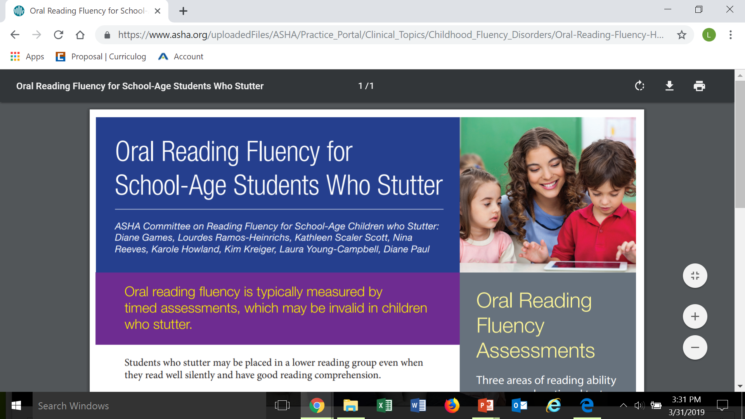


Slide 80
Analysis model

Slide 81
Our Language Expertise enables us to identify …
Language expectations of standards
Language challenges for children with SLI and who are at risk
Appropriate interventions, accommodations, modifications
Integrate intervention with language expectations of the general curriculum

Slide 82
But we can’t do it without collaborating …
Participate in teams
  Standards implementation teams
  Student support teams
Joint planning for intervention
Classroom-based co-teaching
  Whole-class lesson
  Small groups for targeted students

Slide 83

Standards Analysis and Intervention
A Step-wise approach can facilitate integration of the standards with speech-language services

Slide 84
Standards Analysis and Intervention
1: Identify the Standards
2: Identify needed communication skills
3: Analyze student’s current skills and needs
4: Identify classroom challenges
5: Design intervention

Slide 85
1: Identify the Standards
Current grade level
Previous grade levels, to identify prerequisite skills that will not be retaught
Future grade levels, to identify skills that are expected to be developing

Slide 86
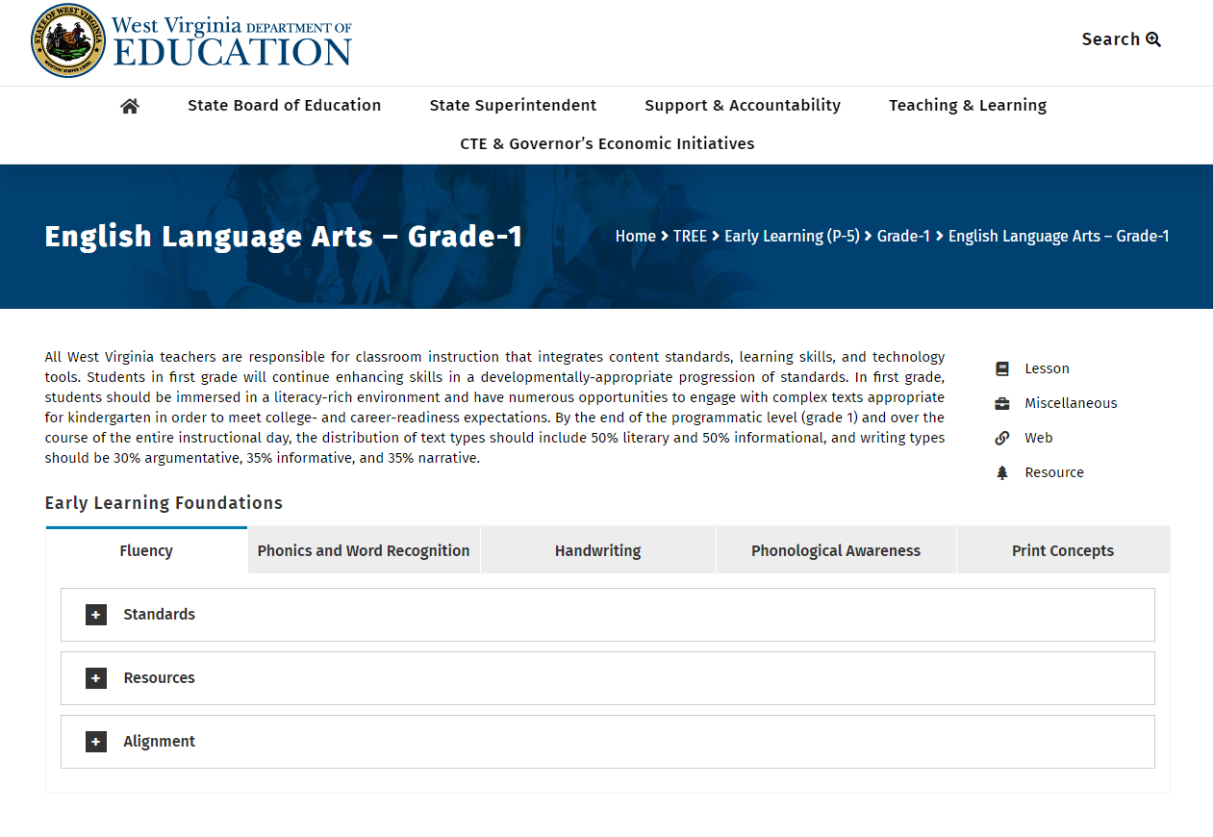
Notes:
West Virginia Department of Education. (n.d.). English language arts—grade 1. Retrieved from https://wvde.us/tree/early-learning-p-5/grade-1/english-language-arts-grade-1/

Slide 87
2: Identify needed communication skills
Analyze standards to identify communication skills needed for attainment
Consider
  Vocabulary
  Morphology and syntax
  Pragmatics
  Phonology
  Meta-linguistic skills

Slide 88
3. Identify student’s strengths and needs
Review IEP/504 Plan
  Evaluation results in Present Level of Performance
  Goals
  Accommodations, modifications and supports
Teacher checklists
SLP probes
State assessment data

Slide 89
Individualize your analysis
Vocabulary probes
  Compare and contrast
  Root word/affix analysis
  Homonyms, synonyms, antonyms
Story re-tells
Group discussions
Pragmatic checklists
1:1 Oral presentations

Slide 90
4. Identify classroom challenges
Secure teacher input
Complete classroom observation
Review instructional materials
Linguistic complexity
Receptive and expressive communication expectations
Metalinguistic expectations
Auditory and visual environments

Slide 91
5. Design intervention
Goal is to facilitate student’s acquisition of the standards
Collaborate with teachers to support transfer of skills to general curriculum

Slide 92

Evidence of student understanding is revealed when students apply (transfer) knowledge in authentic contexts.
        Tomlinson & McTighe (2006)

Slide 93
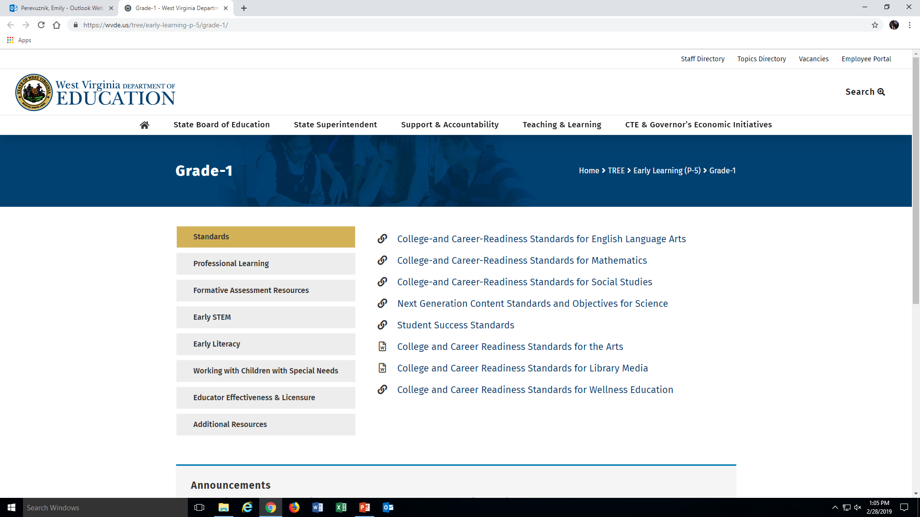
Notes:
https://wvde.us/tree/early-learning-p-5/grade-1/

Slide 94
Application to case studies

Slide 95
Case Study: Child with Language Impairment
Joe is a fourth grader who has received speech-language services since preschool years and has made great progress, yet continues to have a vocabulary deficit.

Slide 96
Step 1:
Review the Standards
  Determine or clarify the meaning of unknown and multiple-meaning words and phrases based on grade 4 reading and content
    a. Use context as a clue to meaning (e.g., definitions, examples or restatements in the text)
    b. Use common, grade-appropriate Greek and Latin affixes and roots as clues to the meaning

Slide 97
Step 1: Review preceding grade levels
Context:
G4: definitions, examples, or restatements in text
G3, G2, G1: sentence-level context

Slide 98
Preceding grade levels: affixes & roots
G4: Common Greek and Latin affixes
  e.g., telegraph, photograph, autograph
G3: Determine meaning when known affix is added
  e.g., agreeable/disagreeable, care/careless
G2: Determine the meaning when a known prefix is added
  e.g., happy/unhappy, tell/retell
G1: Use frequently occurring affix/root word as clue to meaning
  e.g., looks, looked, looking
K: Use most frequently occurring inflections and affixes as clue to meaning
  e.g., -ed, -s, re-, un-, pre-, -ful, -less

Slide 99
Step 2: Analyze needed language skills
Expectation | Needed Language Skills
Use of Context | Comprehension of definition vs. example vs. description Knowledge of syntax to identify part of speech
Use of affixes and roots | Morphological awareness skills: Recognize affixes Isolate the affix from the root Identify morphological constraints (what affixes can be joined to what roots; which affixes are prefixes and which are suffixes) Synthesize affix and root Phonological skills to adjust phoneme and stress as new word is produced

Slide 100
STEP 3: Analyze child’s current skills
PLOAFP:
  Oral and Written Language Scales –II reveal that Joe’s language skills are scattered with significant weaknesses in understanding and use of abstract vocabulary and figurative language.

Slide 101
Teacher report:
  Attentive, yet seldom asks questions
  Frequently slow in completing language arts tasks
  Masters vocabulary if taught in the classroom
  Difficulty with vocabulary generally understood by other students.
Written narrative analysis:
  Heavy use of simple, concrete vocabulary
  Misunderstanding of terminology
  Misapplication of new vocabulary.

Slide 102
SLP probe of morphological awareness skills (from Larsen & Nippold, 2007) revealed weaknesses in understanding meaning of words with affixes
Difficulty identifying and explaining affixes and roots in selected vocabulary from G4 and G3 textbooks

Slide 103
Step 3: Information from the IEP
IEP goal: Joe will demonstrate mastery of 80% vocabulary words from the grade 4 reading, social studies, science and math content by June 15, 2015.
Accommodations:
  use an on-line dictionary program on his classroom computer
  additional time on in-class writing assignments

Slide 104
Step 4: Analyze Classroom challenges
Language Arts, Social Studies, Science and Math texts vocabulary words that may be difficult.
  Mixture of vocabulary that would be mastered at an earlier age and that presented in grade 4.
  His use of words with affixes

Slide 105
Step 5: Design Intervention
Collaborate with Teachers
  Task:
    pre-teach meaning of common prefixes
  Location:
    individual session
    small group in the classroom
  Target vocabulary:
    The teacher identifies the vocabulary he will be teaching the entire class
    The speech-language pathologist focuses on vocabulary that may be difficult for Joe, but would not be the focus of the class instruction.

Slide 106

Teach children to be morpheme detectives
If piglet means ….
What would owlet mean?

Slide 107
Step 5 – Direct Intervention
Focus on morphological analysis skills to master new vocabulary
  The SLP identifies the word “absorption” in the text as an opportunity to teach the meaning and use of the suffix “tion.”
    frequently used suffix that means “act or process.”
  Review the various meaning of “tion” and apply it to the verb “absorb.”
  Joe completes a word web with “tion” in the middle and identifies 6 other words that include the suffix “tion” with a comparable meaning.

Slide 108
STEP 5–Small group in the classroom
Antonym Scale
Country
Neighborhood
Lead students in creating an “antonym scale”
Students complete with various terms that describe geographic groupings of people (e.g., settlement, neighborhood, territory, precinct, city, subdivision, state).
  (from Diamond, L. & Gutlohn, L. , 2009)

Slide 109
Case Study– K Child with limited intelligibility
Anthony is in Kindergarten.
He did not pass the new student screening and was referred for a speech-language assessment.
K teacher says he is very hard to understand – estimate that the class understands less than half of what he says.
He is reticent to speak and tends to play by himself rather than joining in with groups.

Slide 110
Identify the current standards: K Phonological Awareness
Demonstrate understanding of spoken words, syllables, and sounds (phonemes).
  Recognize and produce rhyming words.
  Count, pronounce, blend, and segment syllables in spoken words.
  Blend and segment onsets and rimes of single-syllable spoken words.
  Isolate and pronounce the initial, medial vowel, and final sounds (phonemes) in three-phoneme words (i.e., consonant-vowel-consonant, hereinafter CVC). This does not include CVCs ending with /l/, /r/ or /x/.
  Add or substitute individual sounds (phonemes) in simple, one-syllable words to make new words.

Slide 111
Identify the Upcoming Standards: G1 Phonological Awareness
Demonstrate understanding of spoken words, syllables phonemes
  Orally produce single-syllable words by blending sounds (phonemes), including consonant blends.
  Isolate and pronounce initial, medial vowel, and final sounds (phonemes) in spoken single-syllable words.
  Segment spoken single-syllable words into their complete sequence of individual sounds (phonemes)

Slide 112
Step 2: Identify the needed communication skills
Pronounce phonemes in isolation and coarticulated
Phonological pattern skills related to syllable structure: initial and final consonants, clusters, syllabification

Slide 113
Step 3: Identify current strengths and needs
Strengths:
  Eagerly works with SLP
  Stimulable for all error phonemes except [s] and [r] in isolation and CV or VC syllabic structure
  No vowel errors
  No syllable structure errors (no ICD, FCD, syllable reduction)
  Hearing is WNL
  Oral mechanism examination of unremarkable
  Language screening – WNL
Needs:
  Errors in production of [f s z c y j . ]
  Cluster reduction
  Limited intelligibility (PCC of 72%)

Slide 114
Step 4:
Communication Expectations in the Classroom
Teacher Observation: Errors or non-participation in daily phonological awareness activities identifying initial and final sound
SLP Observation: Incomplete/incorrect responses to teacher’s probes in PA Responding to teacher’s questions throughout the day
Materials: PA materials expect ability to produce phonemes

Slide 115
Step 5
Design Intervention
Direct Services: Individual therapy for 10 minutes, 4 x per week, pulled to one of the quiet centers in the classroom Group therapy for 20 minutes 1x/week
Classroom-Based Services: SLP and teacher jointly lead PA activities, with SLP’s focus on small group activities with A to scaffold his productions

Slide 116
Case Study: Student with Autism (with thanks to colleague Peggy Agee)
Aliyah, age 6, was diagnosed with ASD at age 3.
2 recognizable spoken words: “gotit” which she uses when she wants something/someone and “nonono” which she uses when distressed, agitated, or unwilling.
Inconsistently responds to her name when and appear to be unaware of environmental sounds.
Rarely connects or engages with others. Fleeting eye-contact is noted, most often with adults.
Preferred activity is wandering with a pop-up book in hand, repeatedly opening and closing the book.
  If unavailable, she shrieks, rocks, and pinches herself until it is found and placed in her hands.

Slide 117
Step 1: Identify the Standards
Listen to others with care; Respond to comments of others; ask questions to clarify
Follow agreed-upon rules for discussions (e.g., listening to others and taking turns speaking about the topics and texts under discussion).
Continue a conversation through multiple exchanges

Slide 118
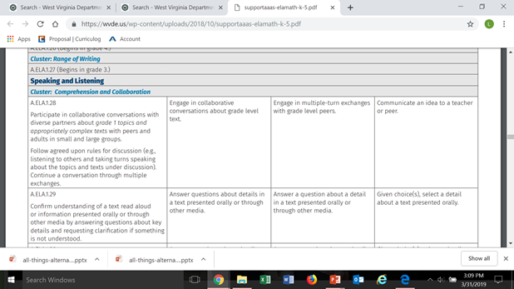
Step 1: Identify the Alternate Standards

Slide 119
Step 2: Identify needed language and communication skills
Pragmatic
  Initiating communication to request
  Responding to name by turning head and body
  Responding to “stop” by cessation of activity
  Playful engagement with an adult
Phonologic
  Expand inventory of phonemes and syllable structures

Slide 120
Step 3: Strengths and Needs
Strengths:
Responds inconsistently to others with brief eye gaze
Uses speech inconsistently in limited situations
Makes a choice by reaching/taking
Needs:
Augmentative/alternative communication means
Frequent, repeated opportunities across the day, embedded in functional activities, to initiate and respond appropriately
Repeated, structured opportunities to playfully engage

Slide 121
Step 4: Classroom challenges
Teacher:
  Frequently becomes anxious due to unknown causes
  No use of speech.
  Only participates in activities with significant adult support
SLP observation:
  No use of gesture or other means of communication to initiate requests during snack or unstructured times
  No purposeful engagement with peers or adults
Classroom expectations:
  Communicate verbally and/or non-verbally
  Engage with adults and peers to participate in all classroom activities

Slide 122
Step 5 – Design Intervention
Direct Intervention: Functional Communication Training
Observe behavioral antecedents and consequences to identify Aliyah’s communicative intent
Replace “behavioral” response with a more appropriate “communicative” one
Enlist teacher and parent support to engage consistent adult facilitation.

Slide 123
Step 5: Design Intervention
Collaborate with Teachers
  Task: to identify functional opportunities for initiation of request using picture exchange; to sample preferred foods, activities, objects
  Location: in classroom; enlist teacher and train paraprofessional
  Target: Aliyah will independently travel to exchange a picture of a preferred object for the object itself.

Slide 124
Step 5: Design Intervention
Collaborate with Teachers
  Task: to identify, script, and embed a playful interaction between Aliyah and an adult which will have a consistent beginning, middle, and ending
  Location: across classroom activities
  Target: Aliyah will use non-verbal behaviors to maintain an interaction with an adult across at least 3 turns.

Slide 125
Collaborative intervention

Slide 126
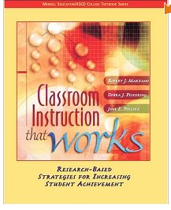
“Marzano Strategies”
Research-based instructional strategies
  Effect of 9 strategies on increased student academic achievement

Slide 127
Increase in Student Achievement
Identifying similarities and differences (45% gain)
Summarizing and note-taking (34% gain)
Reinforcing effort and providing recognition (29% gain)
Homework and practice (28% gain)
Nonlinguistic representation (27% gain)
Cooperative learning (27% gain)
Setting objectives and providing feedback (23% gain)
Generating and testing hypothesis (23% gain)
Questions, cues, and advance organizers (22% gain)

Slide 128
Similarities and Differences
(45% gain)
Comparing
  Similarities and differences between or across things or ideas
  Graphic organizers (Venn diagrams, matrices)
Classifying
  Grouping things that are alike into categories based on their characteristics
  Graphic organizers (matrices, webs)
Create similes and metaphors
  Finding relationships between two topics

Slide 129
Compare and contrast Activity
Eliminate words/phrases that do not belong
“The Civil War”
conflict colonies north | states emancipation west | slavery secession minute men

Slide 130
Paraphrasing is a form of compare and contrast
Identify synonyms for words/phrases
Identify words that are unimportant (cross out)

Slide 131
Nonlinguistic representation results in 27% gain in learning (Marzano)
Graphic representations
  Web organizer, time-sequence patterns, cause-effect patterns
Physical models
Mental pictures/stories
Drawing pictures and pictographs
Engaging in kinesthetic activity
Gains in vocabulary
  37% over using definitions
  21% over generating sentences

Slide 132
Vocabulary Instruction templates

Slide 133
Frayer Model
Word
Definition
Characteristics
Examples
Non-examples
Created by Dorothy Frayer, University of Wisconsin

Slide 134
WORD INVESTIGATION
WORD: ______________________
Rating: 1 2 3 4
Prefix | Root Word | Suffix | Part of Speech
Description: Word History:
Synonym | Antonym | Example | Picture
LPdF: adapted from Tompkins, G.E. (2006). Literacy for the 21st Century (4th ed). Columbus: Pearson

Slide 135
Rate knowledge of the word
Have never heard of the word before
Have heard of the word, but don’t know what it means
Could figure out the word in a sentence
Know the word and can explain it

Slide 136
What New Ideas do You Have?

Slide 137
A Few Content-Specific Examples
Fun with Maps and Thermometers (with thanks to Andrea Brewer)
  Following directions
  Supporting social studies and science Tier 3 vocabulary
Phoneme drill sheet using map-reading skills and Tier2 and 3 vocabulary

Slide 138
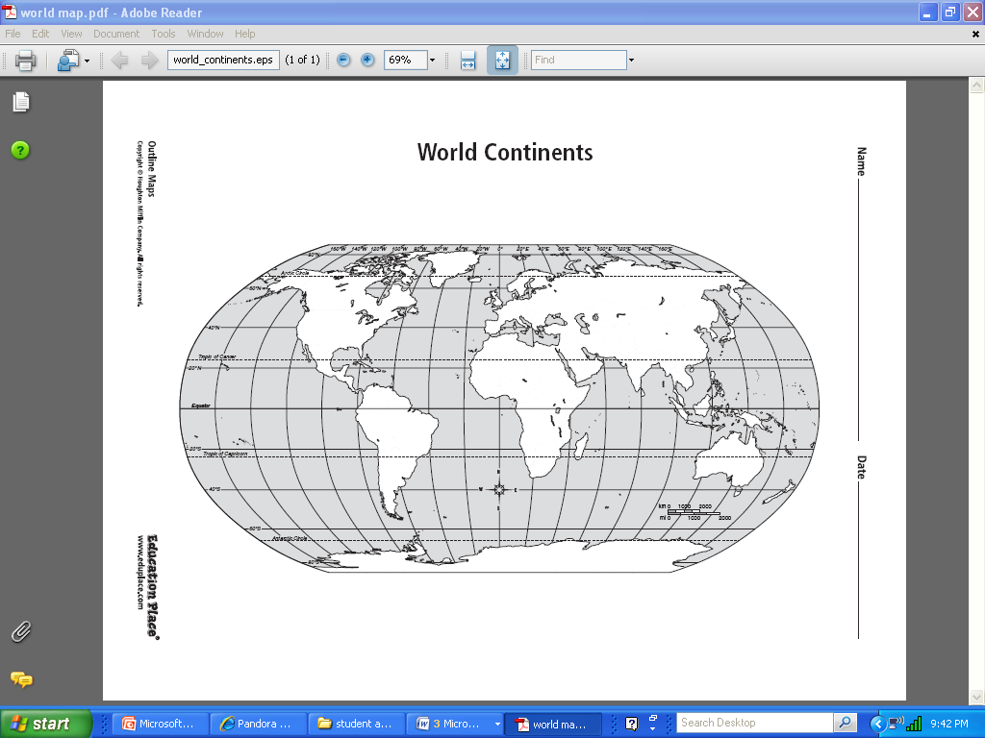
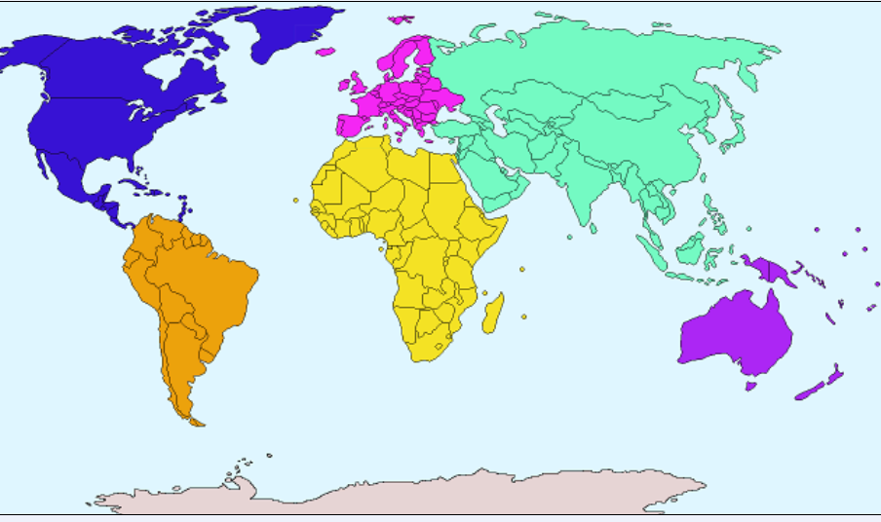
Draw a red circle around China, a red triangle around India, and a red rectangle around the United States.
  What continent are India and China located on?
Retrieved from: www.naturalhistoryonthenet.com

Slide 139
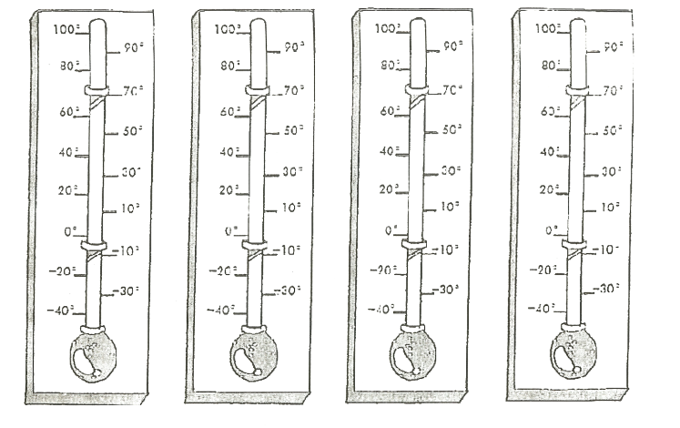
With the red marker, on the third thermometer indicate 70 degrees Fahrenheit and on the fourth thermometer indicate 10 degrees Fahrenheit.
Which thermometer shows the warmest temperature?
Retrieved from: http://www.teachervision.fen.com/measurement/printable/44638.html

Slide 140
[s] drill using map reading skills and
K-2 math/science words (with thanks to Kathleen Sisk)
 | A | B | C | D
1 | sun | star | solar system | brightness
2 | size | science | estimate | universe
3 | season | scientists | decrease | earth’s gravity
4 | circular | gas | answer | distance

Slide 141
Facilitating learning
“Transfer is enhanced by helping students see potential transfer implications of what they are learning.”
“Learners of all ages are more motivated when they see the usefulness of what they are learning …”
    Committee on Developments in Science and Learning, 2000

Slide 142
Don’t forget classroom accommodations, modifications, and supports

Slide 143
Environment
Instruction
Lighting
Reduce classroom noise
Reduce visual stimulation
Post written and pictorial schedules
Verbal and written instructions
Post written and pictorial schedules
Visual prompts
Auditory cues
Advance organizers
Specific feedback

Slide 144
Variety of instructional approaches
Variety of assessment approaches
Traditional auditory (listening) or visual (reading) alone
Motor
Tactile
Combined modalities
Wait times
Use of technology (e.g., FM system, “smart boards”)
Traditional pen and paper tests
Models
Verbal explanation
Pictorial representation
Wait times
Computer based

Slide 145
So … why should SLPs be engaged with education standards?
Our strong background in language and communication enables us to identify the skills students need to master the standards.
It facilitates our students’ mastery of academic concepts

Slide 146
How can we use the standards to explain what we do to educators and parents?
Compare the child’s language skills to the expectations for his/her grade level.
  Communicate the expectations from prior grade levels that have not been met, establishing the educational impact of the language impairment.
  Identify upcoming expectations that SLPs and teachers can support collaboratively.
Analyze the language skills needed for mastery and plan intervention.

Slide 147
Resources?
ASHA Practice Portal and Common Core Standards Info http://www.asha.org/SLP/schools/Common-Core-State-Standards/

Slide 148
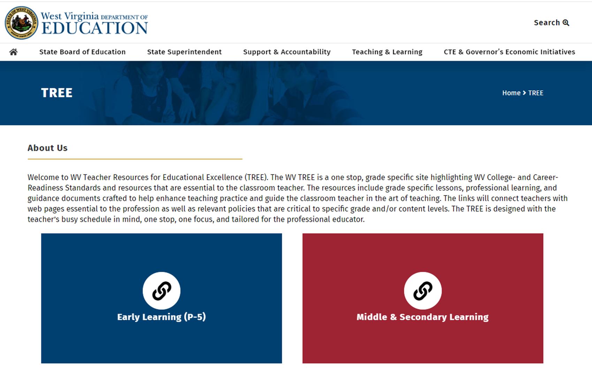

Slide 149

Opportunity is missed by most people because it is dressed in overalls and looks like work.
Thomas Edison

Slide 150
References
Blosser, J., Roth, F. P., Paul, D. R., Ehren, B. J., Nelson, N. W., & Sturm, J. M. (2012, August 28). Integrating the core. The ASHA Leader.
Ehren, B. J., Blosser, J., Roth, F. P., Paul, D. R., & Nelson, N. W. (2012, April 03). Core commitment. The ASHA Leader.
Justice, L. (October 2013). From my perspective: A+ speech-language goals. The ASHA Leader, 19, 10 – 11. Doi:10.1044/leader.FMP.18102013.10.
Larsen, J.A., & Nippold, M.A. (2007). Morphological analysis in school-age children: Dynamic Assessment of a word learning strategy. Language, Speech and Hearing Services in Schools, 38, 201-212.
PA Dept. of Education (2014). Academic standards for English language arts.
PA Dept. of Education (2014). PA Core Standards – Common Core – PA Academic Standard Crosswalk.
Power-deFur, L. (2016). ). Common Core State Standards and the speech-language pathologist: Standards-based intervention for special populations. San Diego: Plural Publishing.
Power-deFur, L. (2010, August 31). The educational relevance of communication disorders. The ASHA Leader.
Power-deFur, L. and Flynn, P. (2013). Integrating Common Core State Standards. ASHA Web Workshop.
Power-deFur, L., & Flynn, P. (2012). Unpacking the standards for intervention. Perspectives on School-Based Issues, 13, 11–16.

Slide 151
Lissa Power-deFur, Ph.D., CCC-SLP
powerdefurea@longwood.edu

